Slide 1
Focus Groups
Doing Political Research

Slide 2

What are Focus Groups?
Group interviews facilitated by a moderator, focused on a particular topic
Number of participants varies, usually between 5 and 10
Levels of analysis
Individual
Group
Interaction

Slide 3
Why Use Focus Groups?
Cyr finds focus groups to be rarely used in social science research
But they are an excellent way to investigate group dynamics
Three uses of focus groups:
Triangulation: corroboration of evidence from other sources/methods
Pretest: checking how other methodological instruments, especially survey questions, are understood by participants
Exploration: finding new knowledge about/interpretations of political phenomena and processes

Slide 4
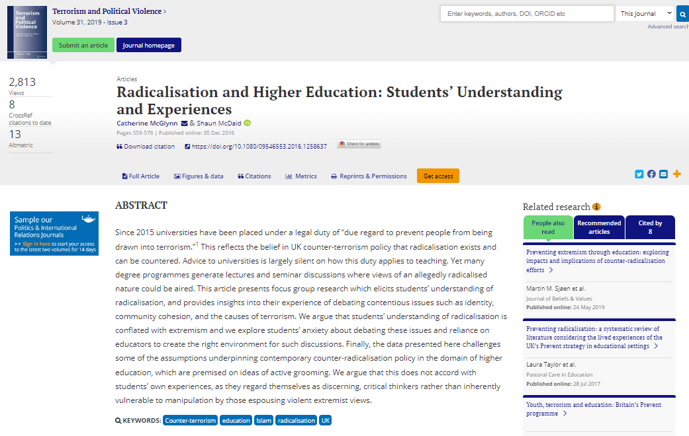
Examples
What Do the Public Think of Taxation? (Prabhakar 2012)
Everyday Narratives of European Border Security and Insecurity (Löfflmann and Vaughan-Williams 2017, 2018)
Students’ understanding of “radicalisation” (McGlynn and McDaid 2019)
Public conceptions and constructions of 'British values’ (Jarvis et al 2020)
How politicised is European integration? (Hurrelmann et al 2015)

Slide 5
Focus Groups vs Individual Interviews
 | Focus Groups | Interviews
Focus of Analysis | Group and interaction | Individual
Role of interviewer/ moderator | Starts discussion, occasionally intervenes | Directs the conversation
Views challenged? | Often, by other participants | Rarely, by interviewer
Structure | Less structure | More structure
Who asks questions? | Moderator and participants | Interviewer

Slide 6
The Process
Recruitment
Practical considerations
Topic guide
Before and after interviews or survey
Transcription
Analysis

Slide 7
Recruitment
Similar issues to finding participants for interviews
Who can you find?
Who is willing to participate?
Who is not included?
Composition of groups
Variation within groups
Variation between groups
What varies (or does not vary)? Age, gender, class, ethnicity, region, political views, form of involvement with your research topic? Guided by your research question

Slide 8
Practical Considerations
Where will the focus groups take place?
How long will they last for?
How many people in each focus group?
Moderator and note-taker?

Slide 9
Topic Guide
What questions will you ask?
Icebreakers/activities
How are they introduced?
Use of prompts: verbal, written, pictures, videos
In what order are questions asked?

Slide 10
Group Dynamics
Social pressures, groupthink, desirability bias
Are these problems or possibilities?
Role of the moderator
How active? Guide discussion, or let it run?
Potential for ‘moderator effects’ similar to ‘interviewer effects’
Moderator and researcher: are they the same person?
Before and after the focus group
Use of questionnaires and individual interviews
How do views change after the focus group experience?
Allows for participants to reflect on the group interaction

Slide 11
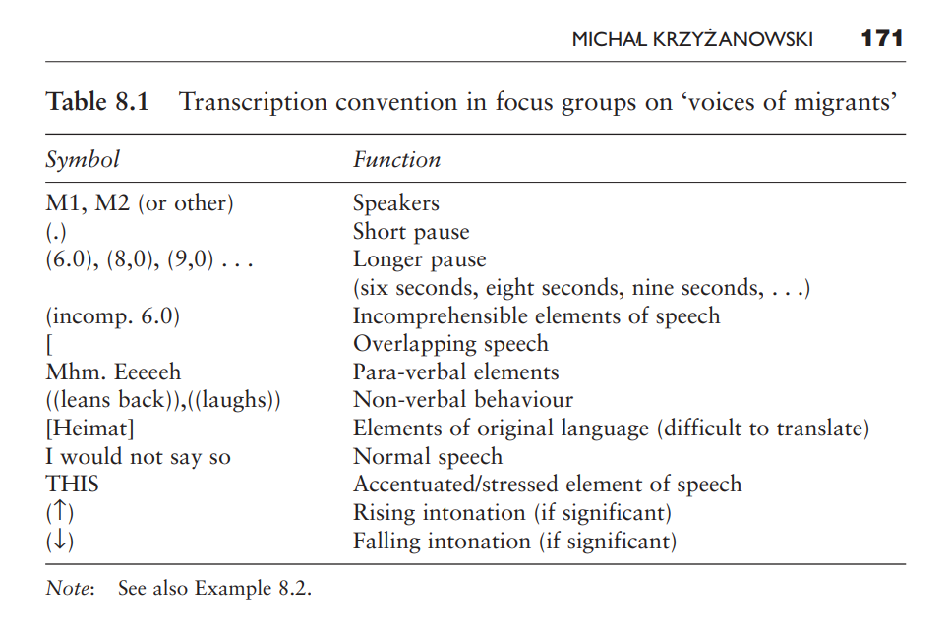
Transcription

Slide 12
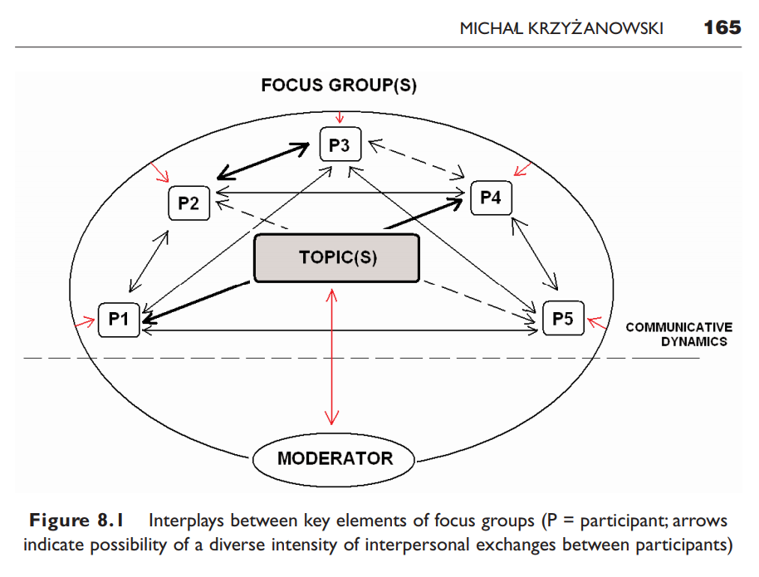
Analysis: Group Dynamics

Slide 13
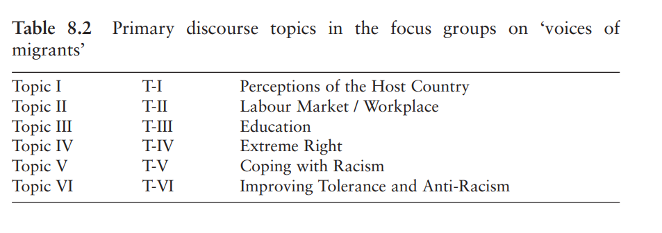
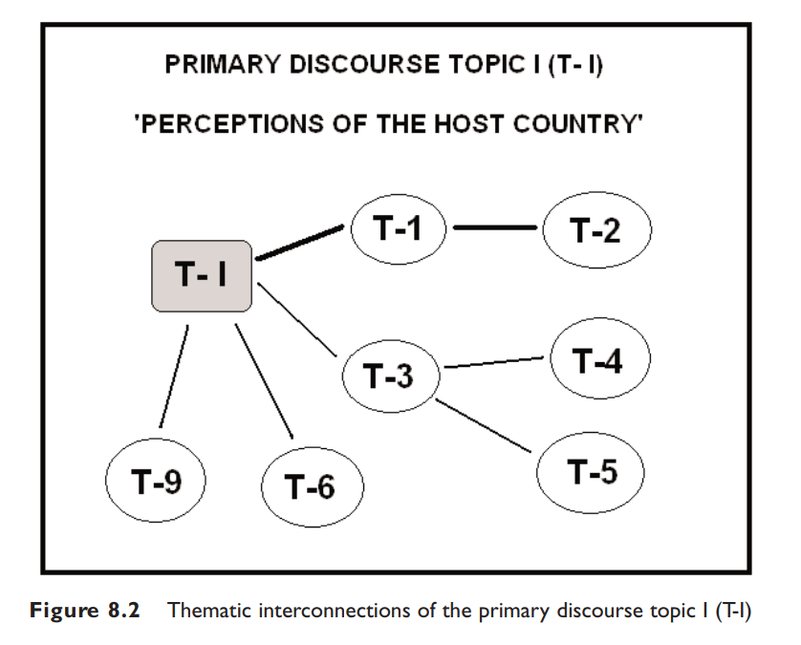
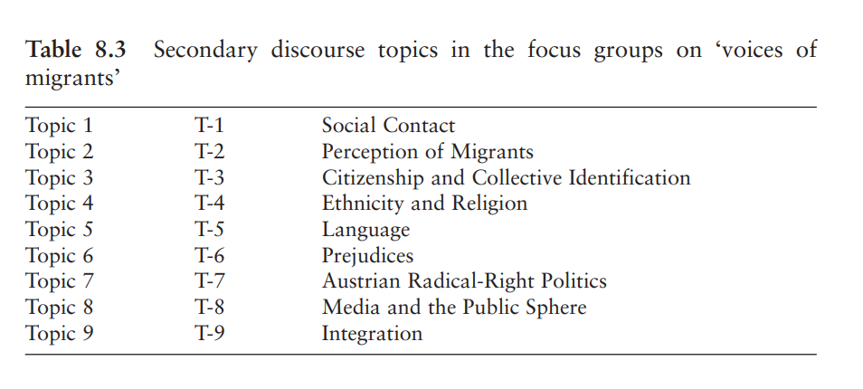
Analysis: Thematic Mapping

Slide 14
Presenting Focus Group Analysis (Cyr)
“Clearly state the main purpose of the focus group in a research design.”
“Specify the unit of analysis exploited in the data collection process.”
“Provide the battery of questions from the focus group.”

Slide 15
Conclusion
Focus groups can be a very important tool to understand group dynamics in thinking about political phenomena
But careful attention needs to be paid to how design choices might influence how participants talk and act
The level of analysis is key: are you interested in individuals, groups or interaction?

